Slide 1
Cache Memory
I2
By Thavorac

Slide 2
Computer
Peripherals
Cache
Main Memory
Keyboard
CPU
Logical Architecture
Mouse
Physical Architecture
Monitor
ISA & Instruction
Speaker
Addressing Modes
Scanner
Printer

Slide 3
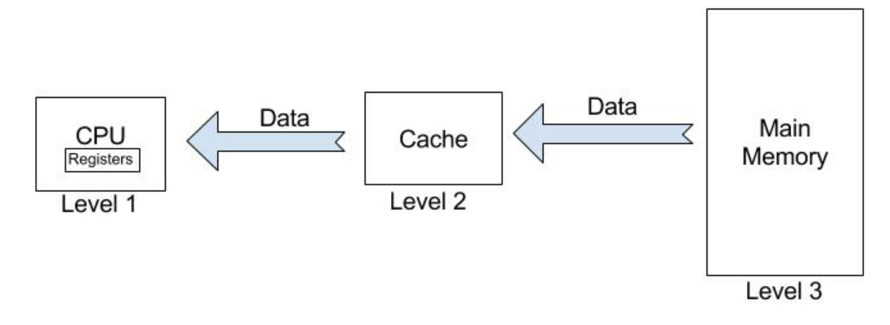
Why memory cache is required
Cache memory is important because it improves the efficiency of data retrieval. It stores program instructions and data that are used repeatedly in the operation of programs or information that the CPU is likely to need next.

Slide 4
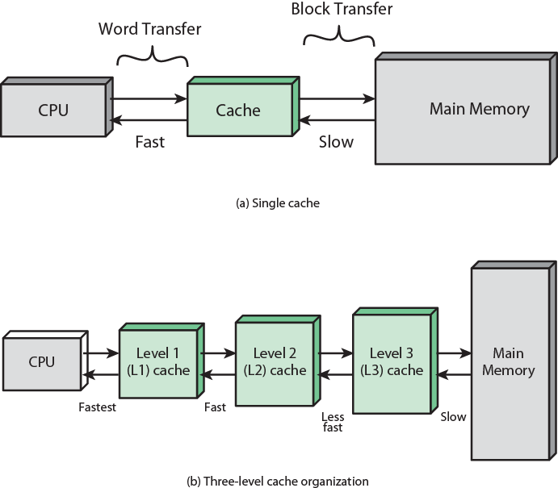

Slide 5
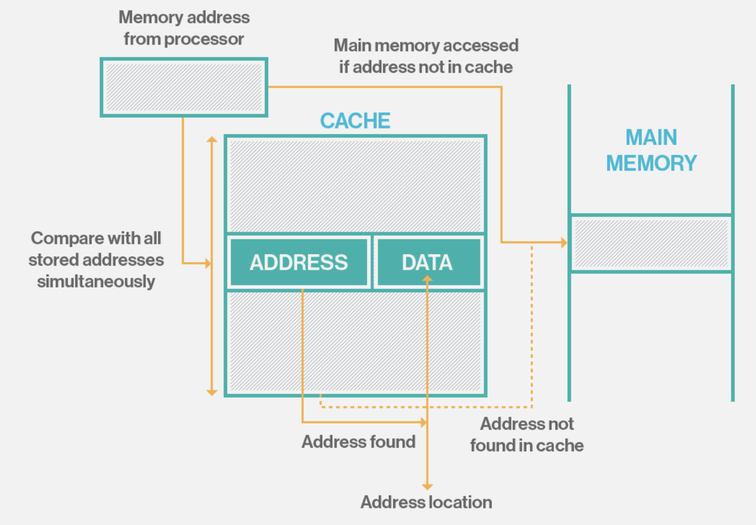

Slide 6
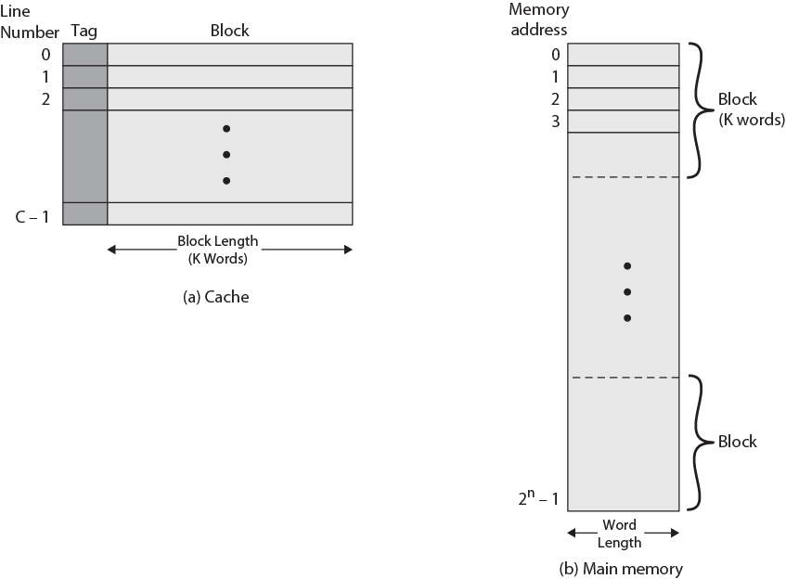

Slide 7
Cache operation - Overview
CPU requests contents of memory location
Check cache for this data
If present, get from cache (fast)
If not present, read required block from main memory to cache
Then deliver from cache to CPU
Cache includes tags to identify which block of main memory is in each cache slot

Slide 8
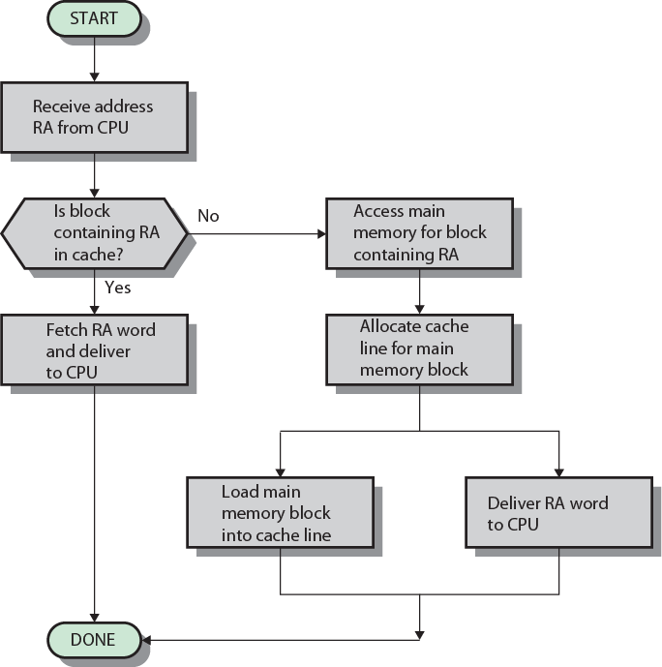

Slide 9
Cache design
Addressing
Size
Mapping Function
Replacement Algorithm
Write Policy
Block Size
Number of Caches

Slide 10
Cache addressing
Where does cache sit?
Between processor and virtual memory management unit
Between MMU and main memory
Logical cache (virtual cache) stores data using virtual addresses
Processor accesses cache directly, not thorough physical cache
Cache access faster, before MMU address translation
Virtual addresses use same address space for different applications
Must flush cache on each context switch
Physical cache stores data using main memory physical addresses

Slide 11
Size does matter
Cost
More cache is expensive
Speed
More cache is faster (up to a point)
Checking cache for data takes time

Slide 12
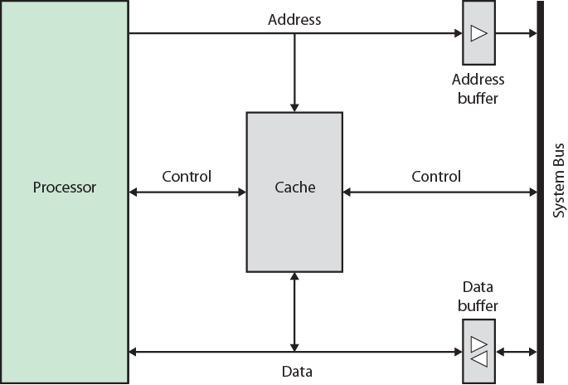
Typical cache organization

Slide 13
Locality of reference
Processors tend to access memory in a very patterned way. if memory location X is accessed at time t, there is a high probability that memory location X + 1 will also be accessed in the near future.
This type of pattern is called “Locality of Reference”. There are other types as well:
Temporal locality—Recently accessed items tend to be accessed again in the near future.
Spatial locality—Accesses tend to be clustered in the address space (for example, as in arrays or loops).
Sequential locality—Instructions tend to be accessed sequentially.

Slide 14
Cache Mapping Schemes
For cache to be functional, it must store useful data. However, this data becomes useless if the CPU can’t find it
RAM
Cache
convert
2E3
Cache mapping scheme

Slide 15
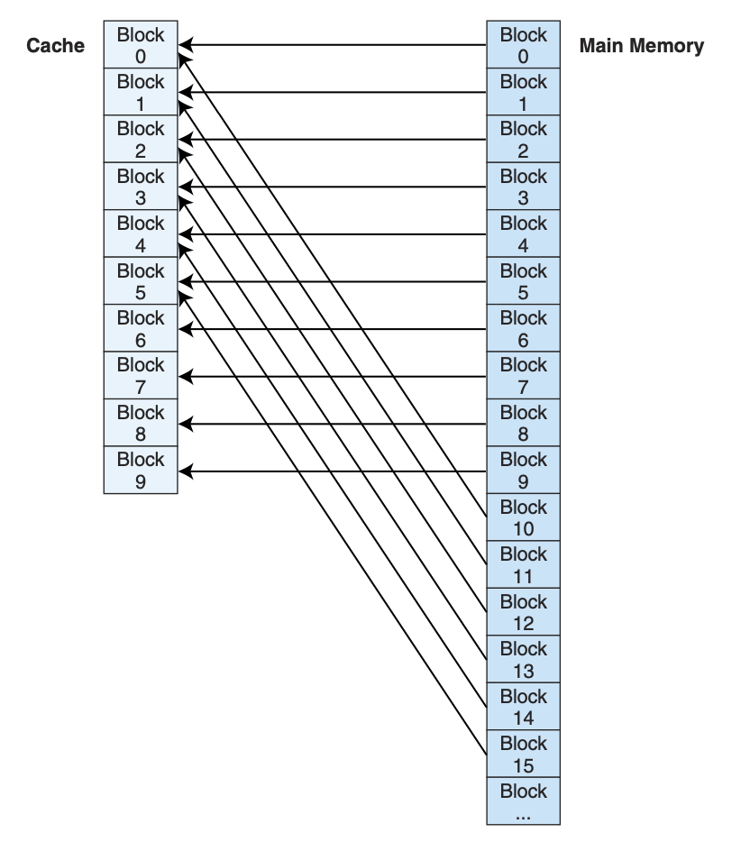
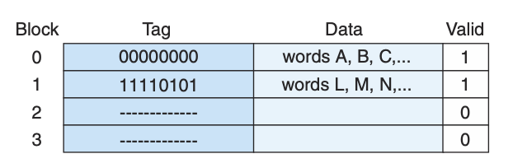
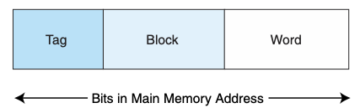
Direct Mapped Cache
Direct mapped cache assigns cache mappings using a modular approach. Because there are more main memory blocks than there are cache blocks, it should be clear that main memory blocks compete for cache locations.
In direct mapped cache, a block of main memory has a specific location in cache.
For example, if cache contains 10 blocks, then main memory block 0 maps to cache block 0, main memory block 1 maps to cache block 1, . . . , main memory block 9 maps to cache block 9, and main memory block 10 maps to cache block 0

Slide 16
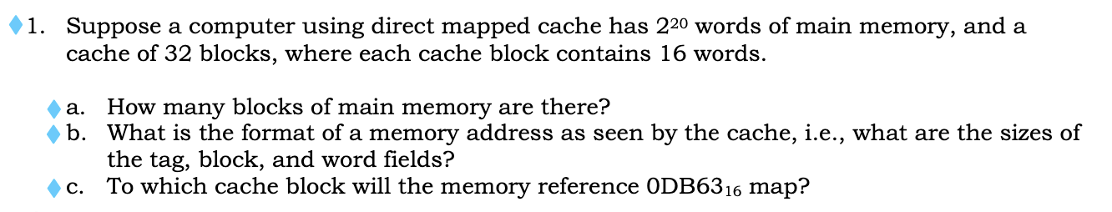
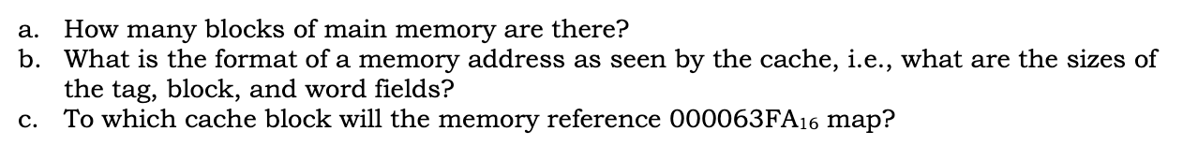
excercise

Slide 17

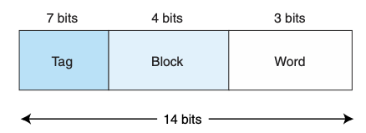
example
Assume memory consists of 2¹⁴ words, cache has 16 blocks, and each block has 8 words. From this we determine that memory has blocks.
We know that each main memory address requires 14 bits. Of this 14-bit address field, the rightmost 3 bits reflect the word field (we need 3 bits to uniquely identify one of 8 words in a block). We need 4 bits to select a specific block in cache, so the block field consists of the middle 4 bits. The remaining 7 bits make up the tag field.

Slide 18
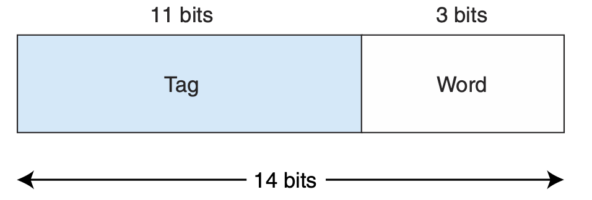
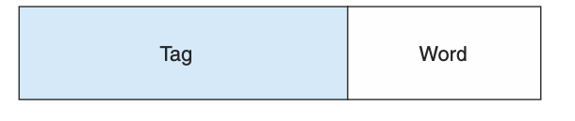
Fully Associative Cache
Direct mapped cache is not as expensive as other caches because the mapping scheme does not require any searching. Each main memory block has a specific location to which it maps in cache
Instead, Fully Associative Cache allows a main memory block to be placed anywhere in cache and searching is done all over the cache.
Example: Consider the memory with 2¹⁴ words, a cache with 16 blocks and blocks of 8 words.
So we have:

Slide 19
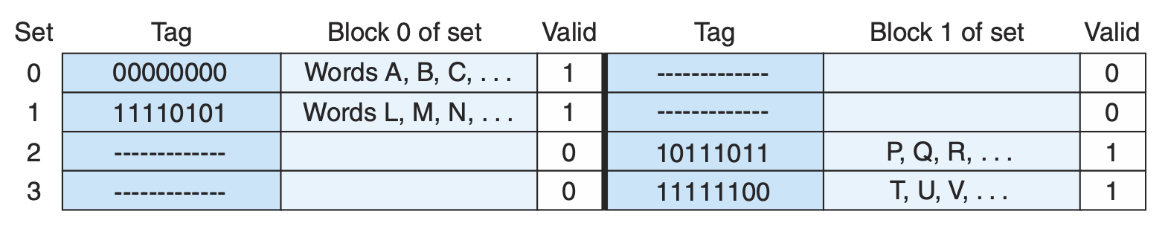
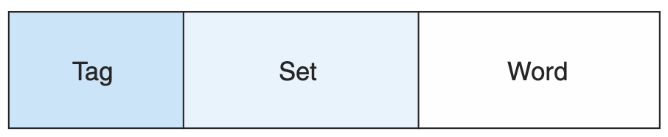
Set Associative Cache
Associative cache is very expensive and direct mapping is inexpensive but very restrictive.
So there is another method which is a combination of fully associative and direct mapping, the N-way set associative. Instead of mapping a block to specific location in cache, but it map block to set instead.
In set-associative cache mapping, the main memory address is partitioned into three pieces: the tag field, the set field, and the word field.

Slide 20
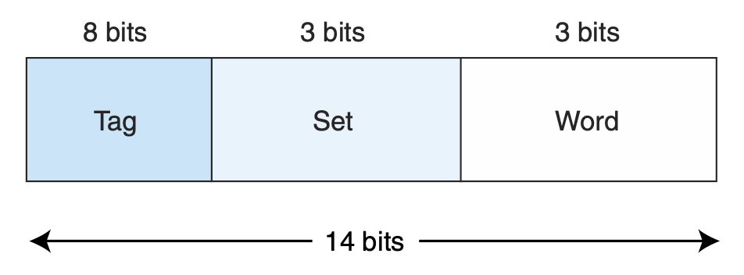
Example
Suppose we are using 2-way set associative mapping with a main memory of 2¹⁴ words, a cache with 16 blocks, where each block contains 8 words. If cache consists of a total of 16 blocks, and each set has 2 blocks, then there are 8 sets in cache.
Therefore, the set field is 3 bits, the word field is 3 bits, and the tag field is 8 bits.

Slide 21
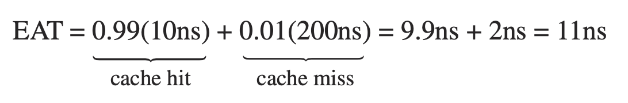

Effective access time and hit ratio
The performance of a hierarchical memory is measured by its effective access time (EAT), or the average time per access.
For example, suppose the cache access time is 10ns, main memory access time is 200ns, and the cache hit rate is 99%. The average time for the processor to access an item in this two-level memory would then be:
where H = cache hit rate, Access_{C} = cache access time, and Access_{MM} = main memory access time.

